Slide 1

JOSHUA

Slide 2
JOSHUA
Yehoshua / Yeshua
Yahweh + Shua (to save) = Yahweh saves
Mentioned by name 27x in Pentateuch

Slide 3
JOSHUA
But you know his proven character, that as a son with his father he served with me in the gospel.
Philippians 2.22

Slide 4
JOSHUA
1st part ~ chapters 1-12
Conquest of the Land
2nd part ~ chapters 13-24
Division of the Land
The giving of the land was unconditional, possessing it wasn't

Slide 5
JOSHUA
Ephesians 1-3 ~ It has been given
… who has blessed us with every spiritual blessing in the heavenly places in Christ…
Ephesians 4-6 ~ So go possess it
I…beseech you to walk worthy of the calling with which you were called…
Ephesians 1.3
Ephesians 4.1

Slide 6
JOSHUA
But in the fourth generation they shall return here, for the iniquity of the Amorites is not yet complete.
Genesis 15.16

Slide 7
JOSHUA
By faith the harlot Rahab did not perish with those who did not believe, when she had received the spies with peace.
Hebrews 11.31

Slide 8
JOSHUA
Rahab
Salmon
Ruth
Boaz
Obed
Jesse
David

Slide 9
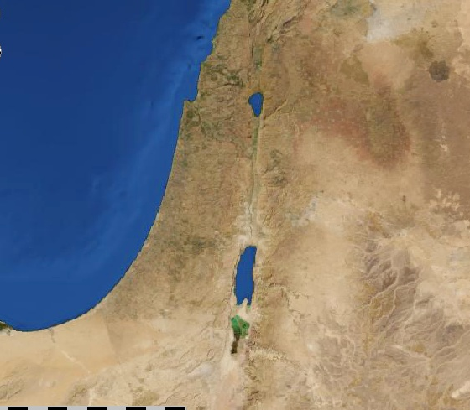
JOSHUA
Gilgal
Conquest of Canaan

Slide 10
JOSHUA
Kedesh
Golan
Ramoth Gilead
Shechem
Bezer
Kirjath Arba
Cities of Refuge

Slide 11
JOSHUA
A man who isolates himself seeks his own desire;
He rages against all wise judgment.
Proverbs 18.1

